Slide 1
Edge Detection
CSCI 4150/6050: Computer Vision
Slides by Dr. Bryan Morse from BYU

Slide 2
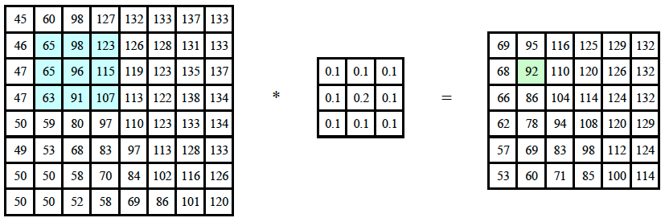

Convolution
notation for convolution operator

Slide 3
Negative Weights
Detecting edges or sharpening images involve finding or accentuating differences
Requires mix of positive and negative weights
The issue with negative weights is we are not sure our results is between 0 and 255. a solution is to use clipping
-1 | 0 | 1
-1 | 0 | 1
-1 | 0 | 1
-1 | 0 | 1
-2 | 0 | 2
-1 | 0 | 1
1 | -2 | 1
1 | -2 | 1
1 | -2 | 1
0 | -1 | 0
-1 | 5 | -1
0 | -1 | 0
Specifically this for sharpening, ie central
value is bigger than
Its neighbors sharpening that pixel more

Slide 4
Unsharp Masking
Originated in analog darkrooms
Key idea: mask (subtract) out the blur
Procedure:
  Blur more (yes, really!)
  Subtract from original
  Multiply by some fraction
  Add back to the original

Slide 5
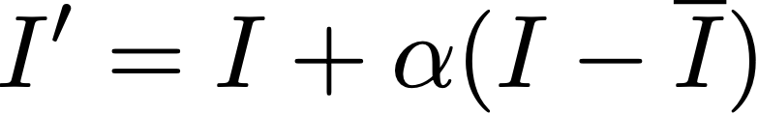




Unsharp Masking
Mathematically:
  Input image
  Blurred input image
  Weighting (controls sharpening)
  Output image

Slide 6
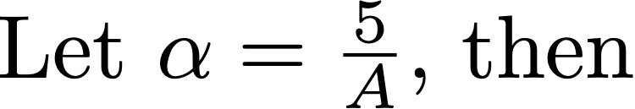
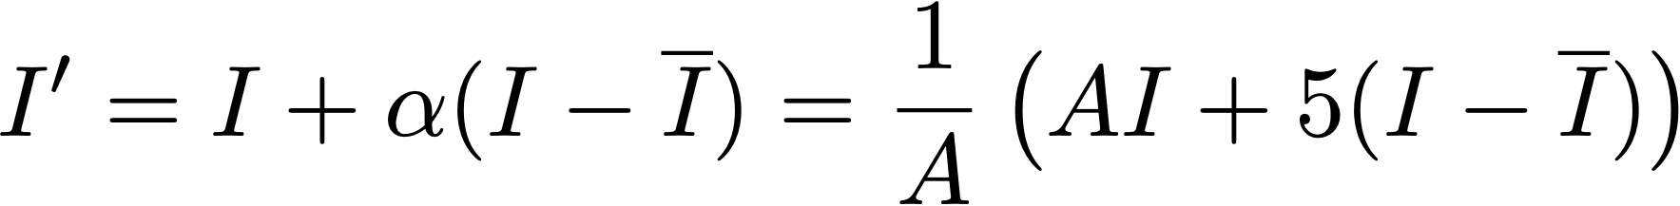
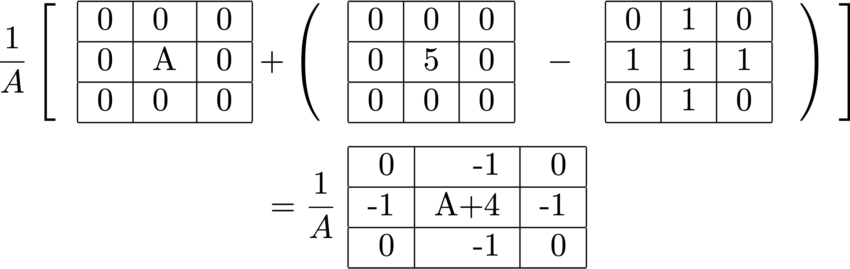
Unsharp Masking
Smaller alpha means less sharpening, we still are not in range and have to clip.

Slide 7
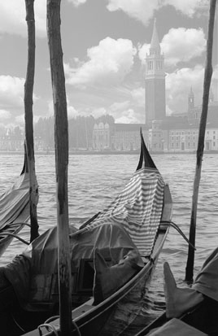
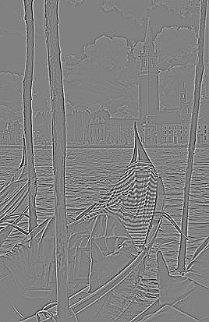

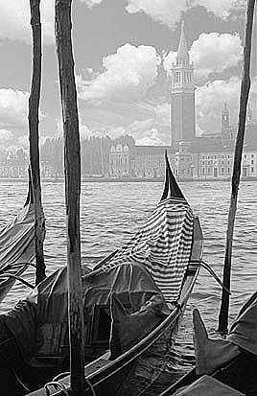
Unsharp Masking

Slide 8
Tradeoff
Blurring:
  Reduces noise
  Causes blur
Sharpening:
  Reduces blur
  Strengthens noise

Slide 9
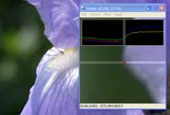
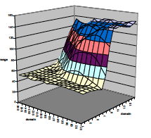
Edge Detection
Edges between objects in images are often places where there are strong changes
Find these using (approximations to)
image derivatives

Slide 10
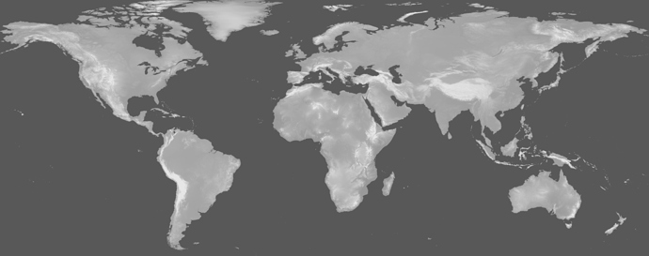
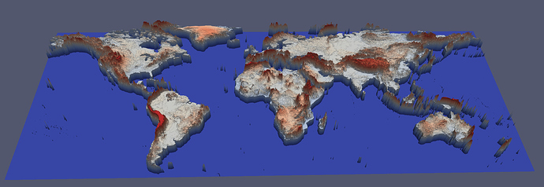
Thinking of an image as a surface…
Image is the surface, the colors show the
Height of the image, and edge detection just
Looks at the cliff ie a big change from one
Color to another.
https://discourse.paraview.org/t/visualizing-2d-image-as-a-surface/2282/2

Slide 11
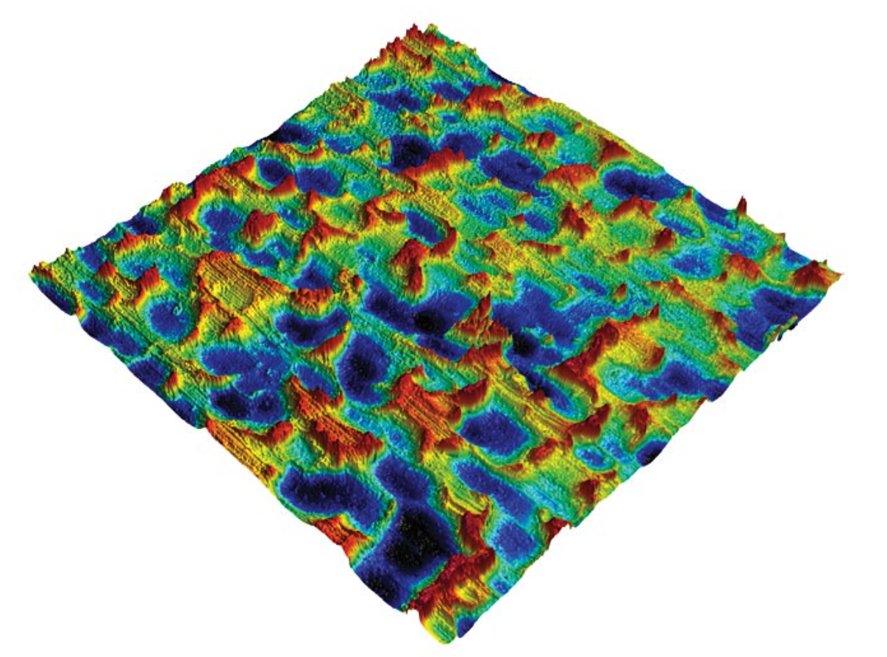
Thinking of an image as a surface…
f(x,y) = z
https://www.qualitymag.com/articles/95593-how-to-make-the-right-choice-between-2d-vs-3d-in-surface-metrology

Slide 12
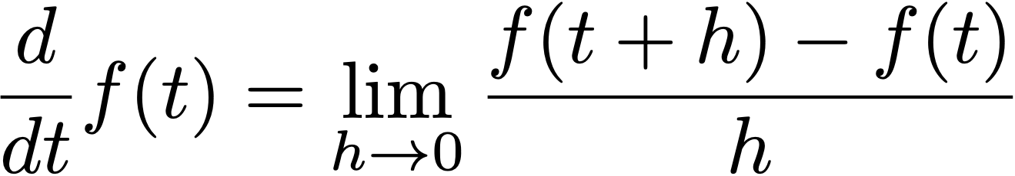
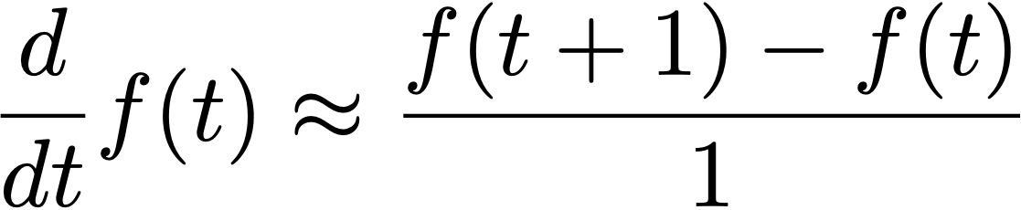
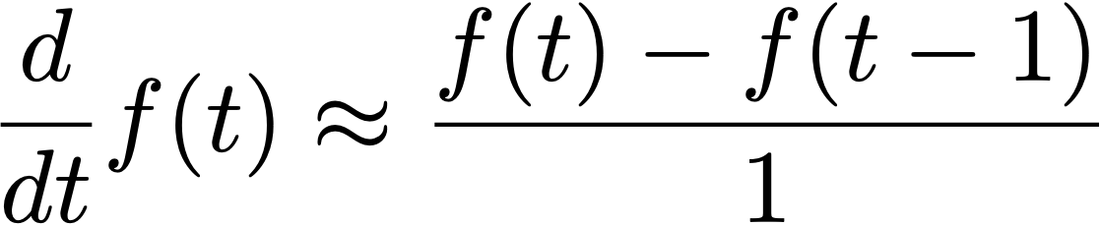
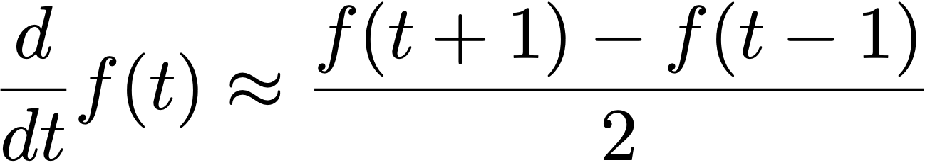
Approximating Derivatives
Ie look at your position, move over one pixel and find the difference. That is used here as the derivative
We use the central derivative (best)
Can approximate derivatives with finite differences
Can choose
  Forward (right)
  Backward (left)
  Central

Slide 13
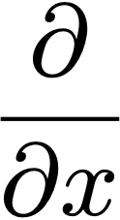
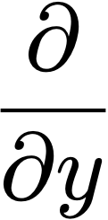
Approximating Derivatives
Simplest:
Just take central differences horizontally and vertically
Approximates partial derivatives
0 | 0 | 0
-1 | 0 | 1
0 | 0 | 0
0 | -1 | 0
0 | 0 | 0
0 | 1 | 0
(Divide by 2, the separation c
between the pixels you’re taking the difference between)

Slide 14
Prewitt Kernels
Better still:
Average in other direction
More robust since you’re reducing noise in one direction while taking derivative in the other
-1 | 0 | 1
-1 | 0 | 1
-1 | 0 | 1
-1 | -1 | -1
0 | 0 | 0
1 | 1 | 1
(Divide by 3, the sum of the averaging weights)
(Divide by 2, the separation
between the pixels you’re taking the difference between)

Slide 15
Sobel Kernels
Ie so final normalisation is dividing by 8. ie 1/4*1/2=1/8
More common:
Use a center-weighted average
More robust to noise
-1 | 0 | 1
-2 | 0 | 2
-1 | 0 | 1
-1 | -2 | -1
0 | 0 | 0
1 | 2 | 1
(Divide by 4, the sum of the averaging weights)
(Divide by 2, the separation
between the pixels you’re taking the difference between)

Slide 16
2nd Derivatives
Can also do second derivatives
Differences of differences
Can still combined with smoothing in other direction
0 | 0 | 0
1 | -2 | 1
0 | 0 | 0
0 | 1 | 0
0 | -2 | 0
0 | 1 | 0
1 | -2 | 1
1 | -2 | 1
1 | -2 | 1
1 | 1 | 1
-2 | -2 | -2
1 | 1 | 1

Slide 17
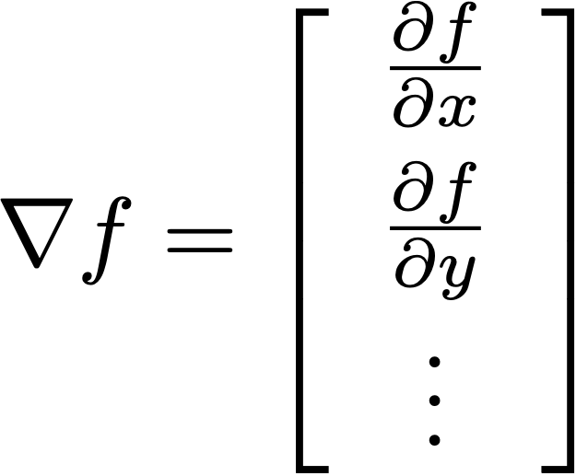
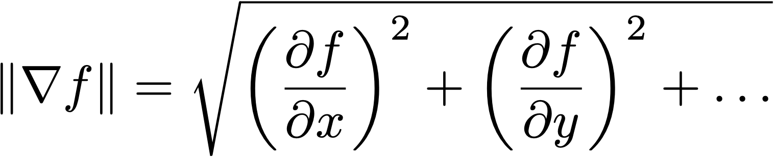
Gradients
The gradient is a vector of partial derivatives with respect to each of a function’s inputs
The direction of the gradient is the
direction of greatest increase
The magnitude of the gradient is the
amount of increase in that direction

Slide 18
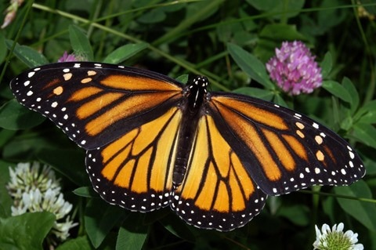
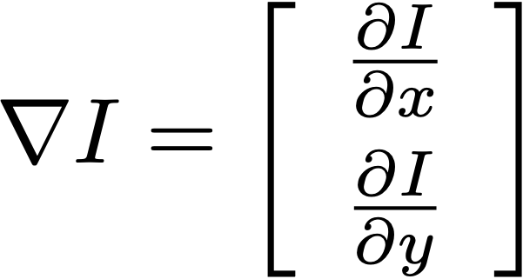
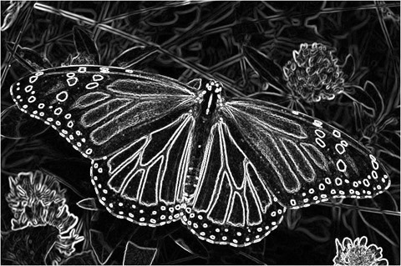
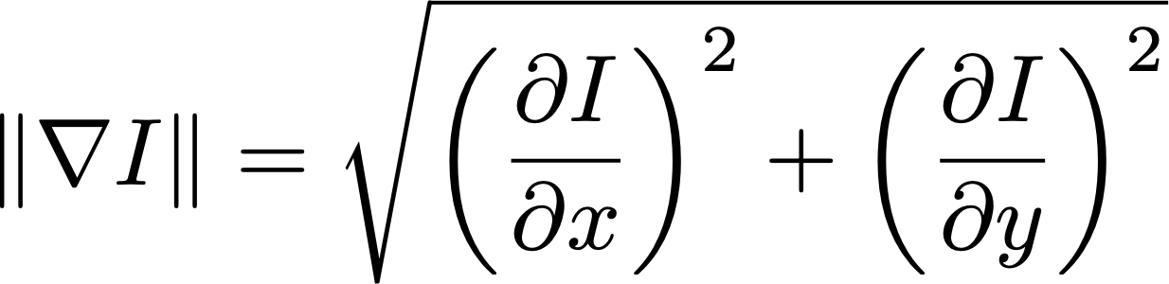
Gradient Magnitude
Instead of getting only horizontal or vertical edges, to get both and even angle edges, use the sobel kernels x and y derivatives and find the gradient as seen below.
See numpy implementation in book
The magnitude of the local gradient is the most common form of edge detector

Slide 19
Common Edge Detector Variations
1st Order Approximators
  Prewitt
  Sobel
2nd Order Approximators
  Hessian
Combination Algorithms
  Canny Edge Detector
Implement this one for your lab
Use this one in real-world applications

Slide 20
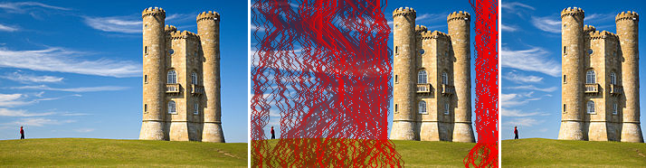
Cool Application: Seam Carving
Shrink an image keeping contents by checking the pixels with the least amount of edges ie the sky and removing them.
Can be used to remove people in photos just highlight them and give them a zero edge so the application removes them effortlessly
https://www.youtube.com/watch?v=6NcIJXTlugc

Slide 21
Lab #2
Level operations with color:
  Convert to grey (1)
  Adjust brightness (2)
  Adjust contrast (3)
Image blending (4)
Uniform averaging (5)
Median filtering (6)
General convolution (7)
Sharpening (8)
Gradient magnitude (9)
For this lab, you may not use OpenCV, Scikit, or np.convolve
You must implement each function using basic NumPy operations.

Slide 22
An Alternative Approach:
Fourier Transform
We will now discuss a completely different way of thinking about image convolution that involves using the Fourier Transform.
This is a deep and mathematically rich topic, but we will focus on the key ideas and big picture.
If you would like to learn more, additional resources and slides are provided on Canvas.

Slide 23
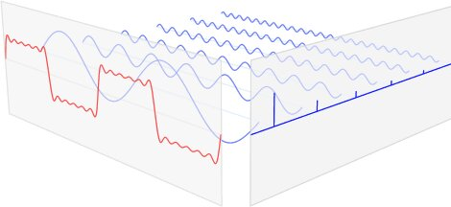
Frequency Domain
This is just turning a signal into its frequency components. Ie the sign signal below ie the freq domain component is used and stored instead of the entire frequency. This saves space??
Key Idea: Any periodic function can be recreated as a sum of sine waves.
A digital signal can be represented by storing the amount of each sine-wave frequency needed.
This is called representing the function in the frequency domain.
The Fourier Transform converts a signal into frequency coefficients.
Signal
Frequency
Domain
https://www.ritchievink.com/blog/2017/04/23/understanding-the-fourier-transform-by-example/

Slide 24
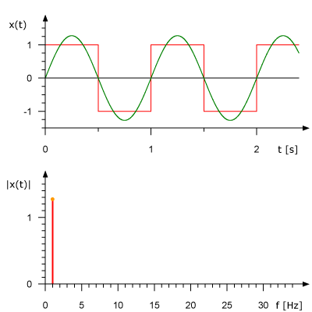
Frequency Domain
As we add more and more components, we move from the green sinosoidal look to a squarelike look closer to the original audio. This is used in reconstruction after staorage. Eg in audio, its
Difficult to spot the differnece between this and the original. Good for mp3 storage / compression

Slide 25
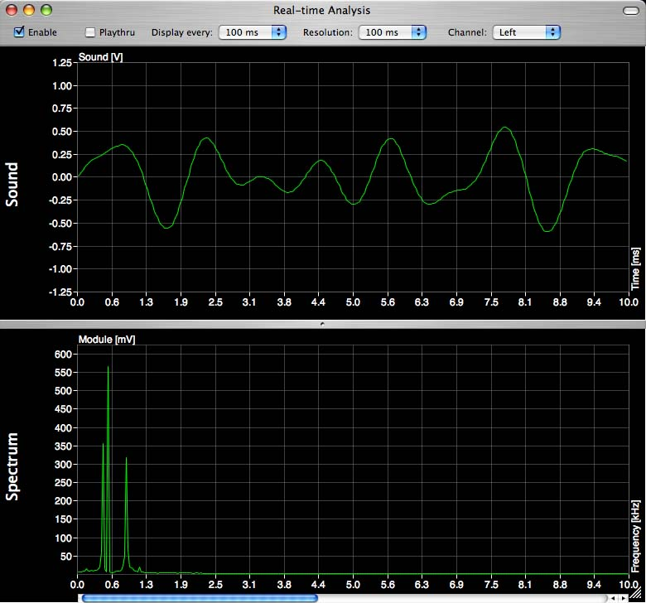
Frequency Domain

Slide 26
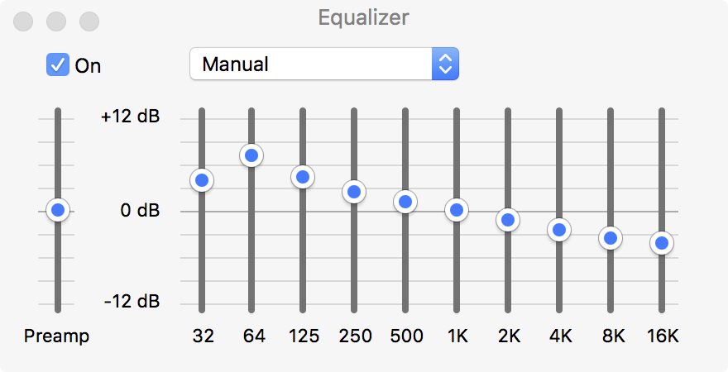
Frequency-Domain Processing
The simplest way to process signals in the frequency domain is to
  Selectively amplify (boost)
  certain frequencies
  Selectively attenuate (weaken) other frequencies

Slide 27
Filtering
Designing and applying a transfer function/modification to a signal in the frequency domain it is called filtering
Process:
  Use Fourier Transform to convert a signal to the frequency domain
  Apply modifications
  Use Inverse Fourier Transform to convert signal back

Slide 28
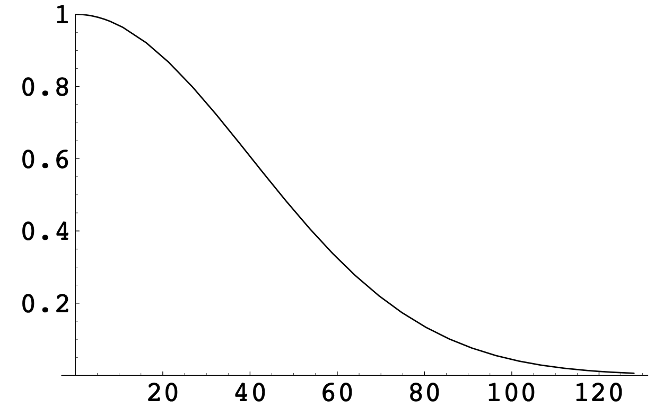
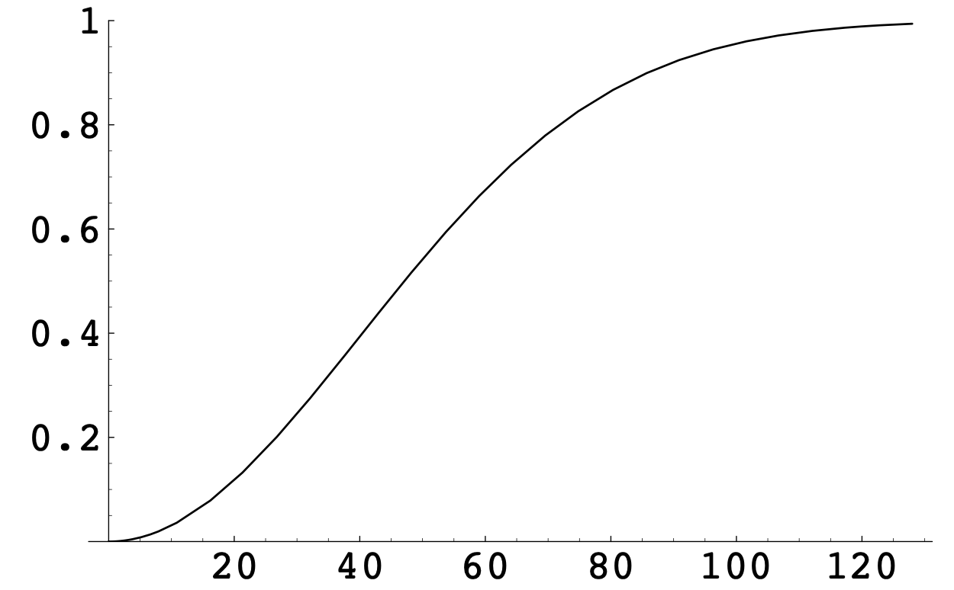
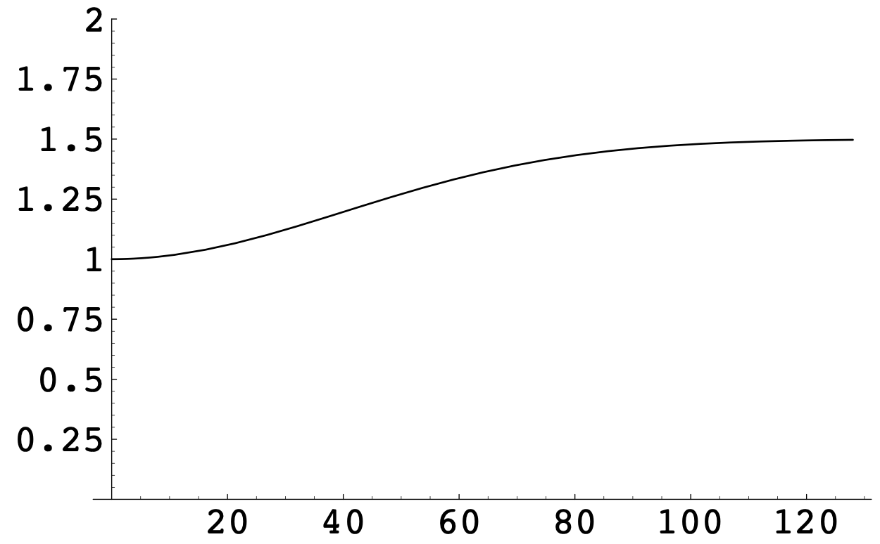
Types of Filters for Sound
Low-Pass
Keeps low frequencies, removes high-pitched noises/hissing.
High-Boost
Keeps low frequencies, boost high frequencies (e.g., human speech)
High-Pass
Keeps high frequencies, removes low-pitched rumbles

Slide 29
Example

Slide 30
If we can represent a 1-D function as a weighted sum of 1-D sine functions, can we represent an image as a weighted sum of 2-D sine images?

Slide 31
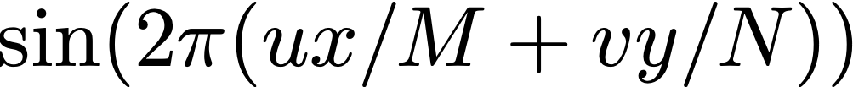
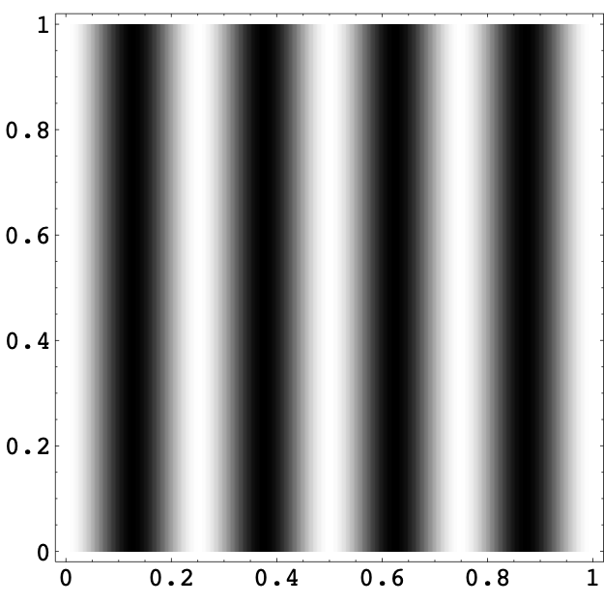
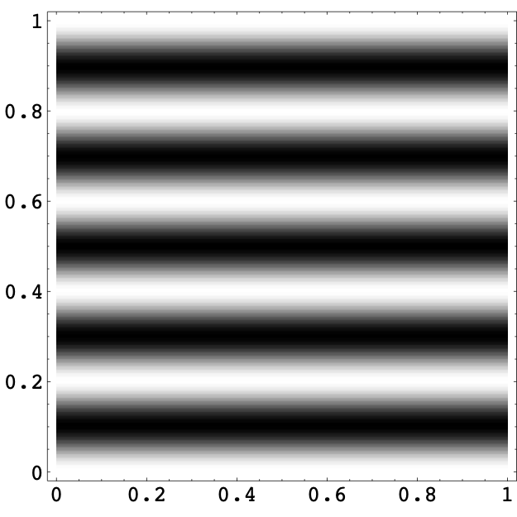
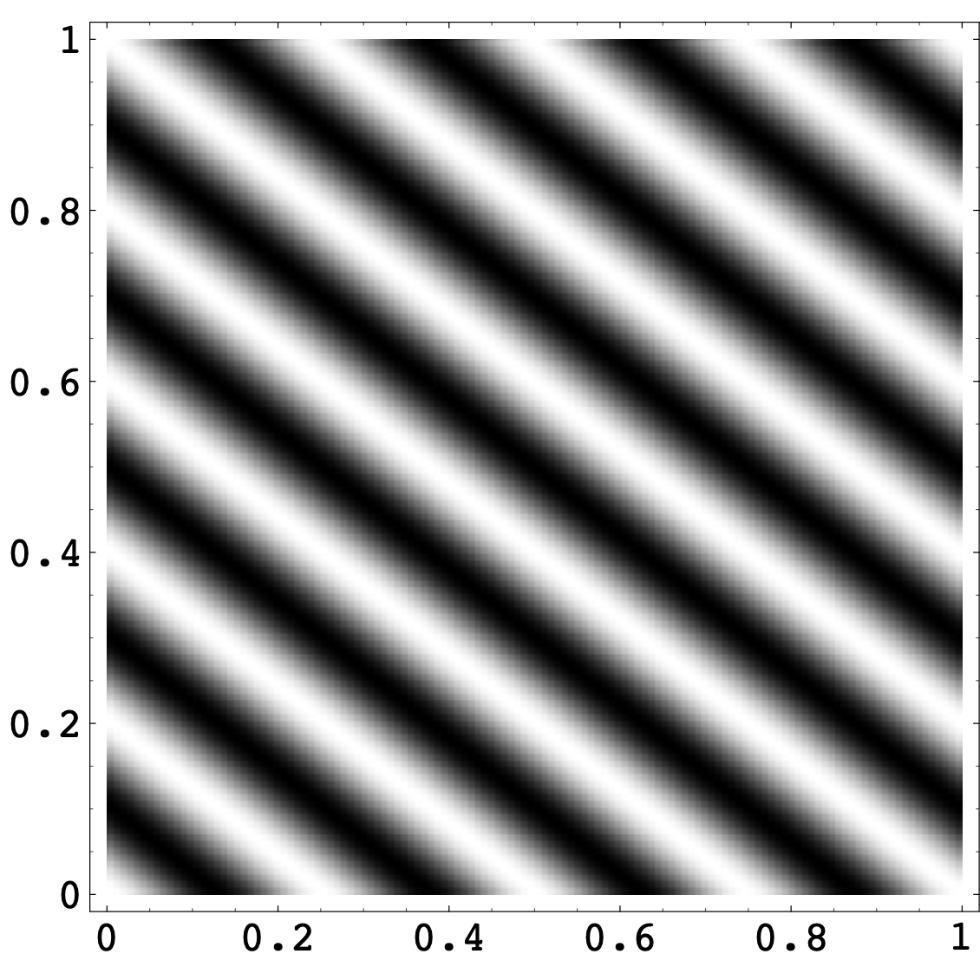
The 2D Discrete Fourier Transform
Uses sine functions of two variables
  u = frequency in the x direction
  v = frequency in the y direction
For an N x M image:
u = 4, v = 0
u = 0, v = 5
u = 4, v = 5

Slide 32
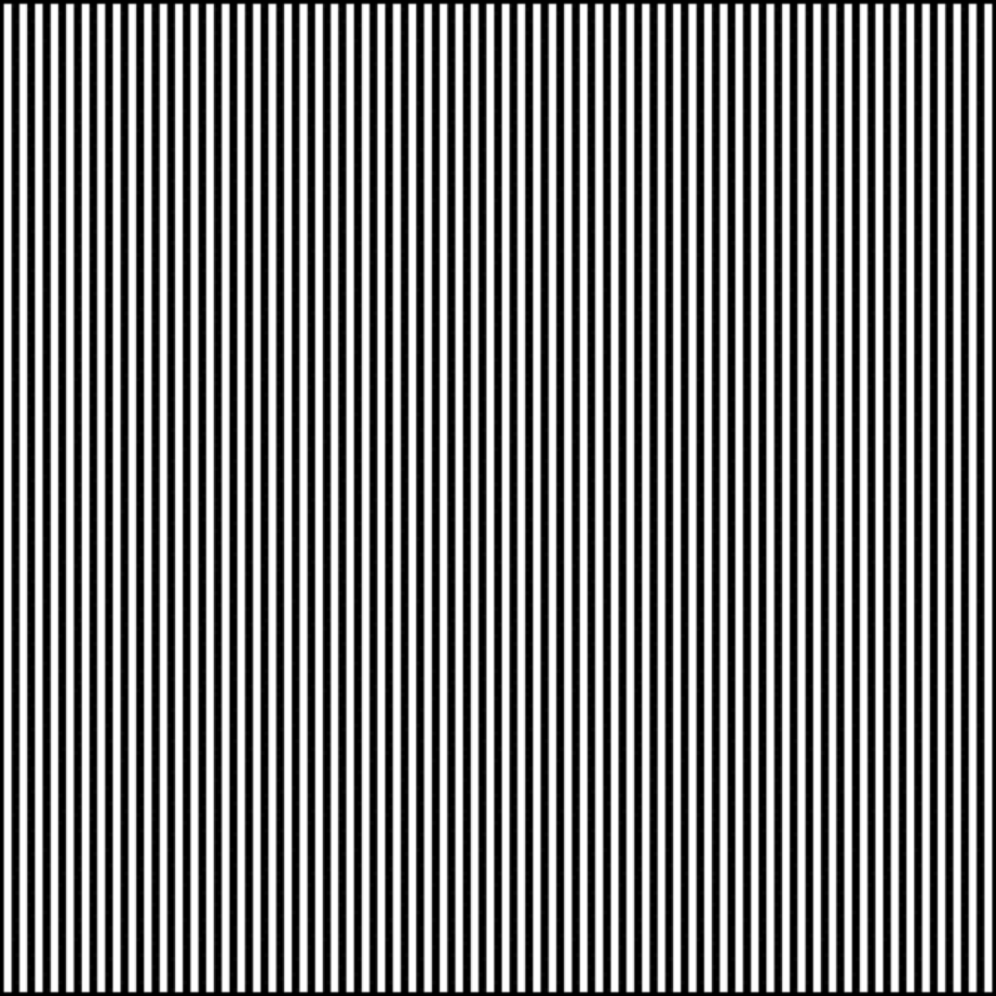

Examples
The angle for the sine waves are moving horizontally as seen with the 3 small white dots.

Slide 33


Examples
Here the sign waves are moving diagonally

Slide 34
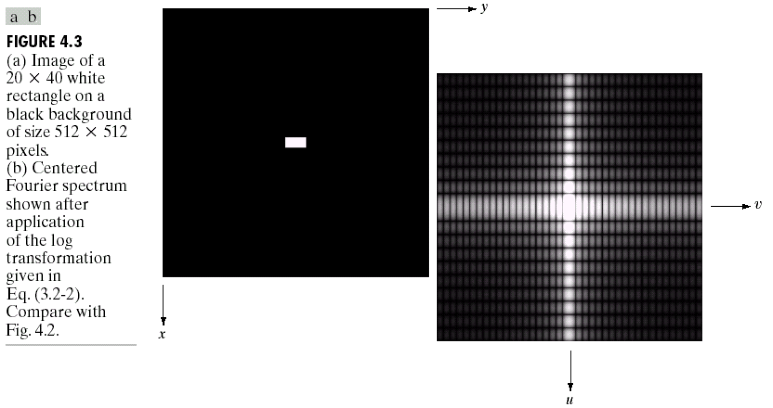
Examples

Slide 35
Another Example
Jean Baptiste
Joseph Fourier
His Fourier Transform

Slide 36
Filtering Images in the Frequency Domain
Low freq mean there is minimal change. High frequency means there are more edges and we can use the high pass filter in edge detection
This can do same thing as convolution kernels, but the convolution kernels are faster for basic transformations.
Just like we can filter 1-D signals, we can also filter 2-D images
  Fourier transform the image
  Multiply by the filter
  Inverse Fourier Transform
Low-pass filtering = blurring
High-pass filtering = edge detection
High-boost filtering = sharpening

Slide 37
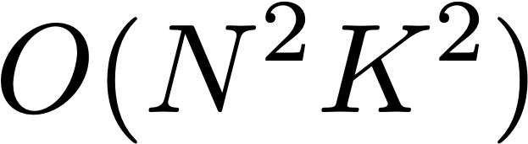
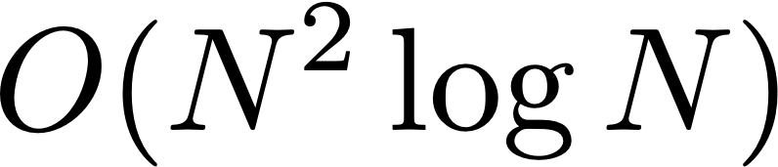
The Need For Speed…
Convolution of an N x N image with a K x K kernel:
FFT the signal, FFT the kernel, inverse FFT:
For large kernels, doing it in the frequency domain can be faster!
General rule of thumb, the break-even point is 7 x 7 kernels

Slide 38
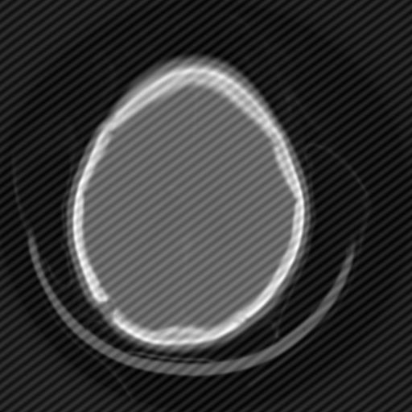
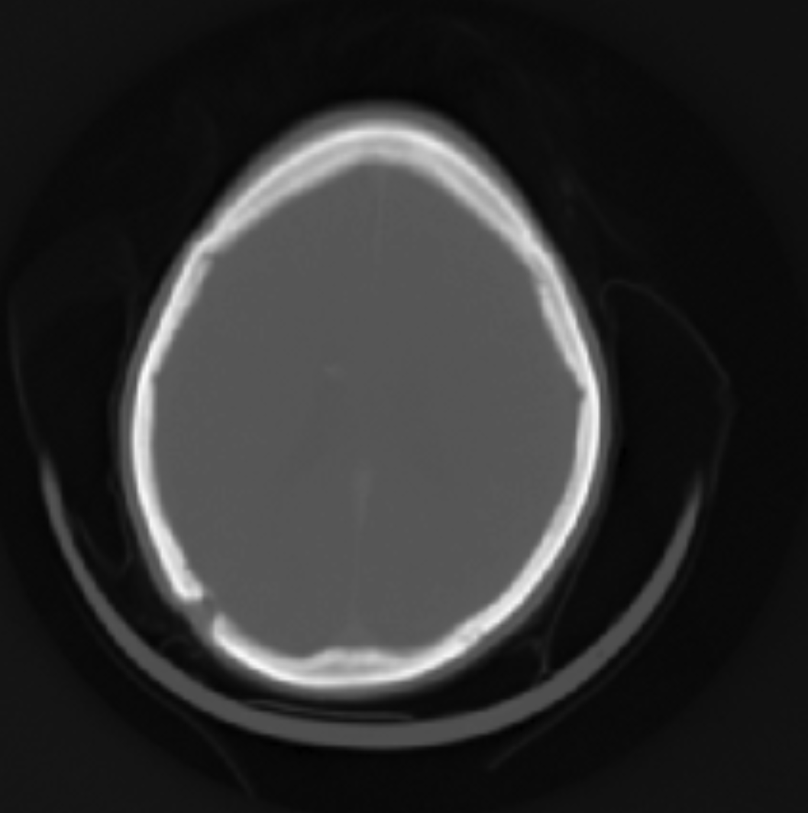
Application: Scan Noise
Application of frequency domain, etc is in jpeg copression, ie get rid of a lot of frequencies but still keep a lot of information about it. Also to reconstruct the image, the fourier transform is symmetric around the center
So just keeping one quadrant is enough to reconstruct after in the different axes.
Also good in medical image processing to remove scan noise

Slide 39
Additional details and resources about the Fourier Transform and Convolution Theorem can be found on Canvas

Slide 40
Coming up...
Points, vectors, matrices and other concepts from linear algebra
Coordinate systems
Transformations

